Slide 1






“EventHub”
Presented by:
Harshal Patil
Prasad Patil
Pratap Bhosale
Akash Salvi
240343020040
240343020071
240343020072
240343020087
Guided by: Snehal Somvanshi

Slide 2

Area of Application:
Our EventHub web application specializes in facilitating seamless coordination for music concerts, art exhibitions, and comedy shows.
Geared towards event organizers, the platform offers an intuitive interface for managing event details such as ticketing, seating arrangements, and promotional activities. Organizers can efficiently plan and execute events of varying scales, ensuring a smooth workflow. Meanwhile, for attendees, the application provides a user friendly experience to browse, select, and book tickets for these diverse events. Whether it's a captivating music concert, an inspiring art exhibition, or a laughter-filled comedy show, our platform enhances the overall event experience. With a focus on key locations and venues within cities, our application ensures that both organizers and attendees have a centralized hub for successful and memorable events

Slide 3
Need of the System:
Organizing and participating in events can be a complex and time consuming process, often plagued by challenges such as inefficient planning, limited accessibility, and fragmented communication. Our event booking web application addresses these pain points by providing a centralized and user-friendly solution for both event organizers and attendees.
For organizers, the system streamlines the event planning workflow, offering tools to manage ticketing. The application also enhances communication and collaboration among event teams, fostering a more efficient planning process. On the attendee side, the need for a simplified and accessible platform for discovering and booking events is met.
Our system ensures a seamless and personalized experience, allowing attendees to explore and reserve tickets for music concerts, art exhibitions, and comedy shows with ease. By addressing these critical needs, our event booking web application aims to revolutionize the event management landscape, making it more efficient, organized, and enjoyable for all stakeholders.

Slide 4
Business Use Cases:
Admin
Organizer
Attendee

Slide 5
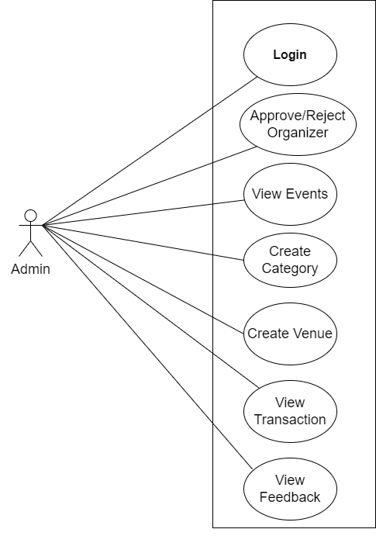
Use Case:
Admin :

Slide 6
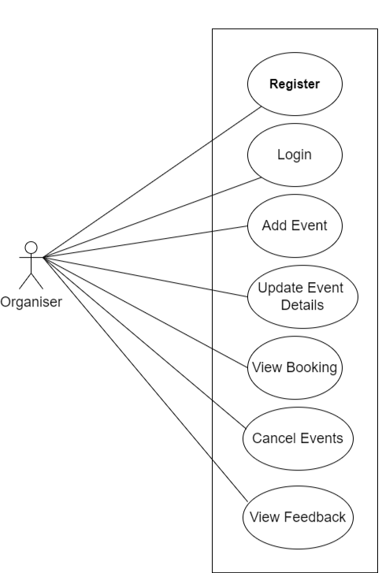
Use Case:
Organizer :

Slide 7
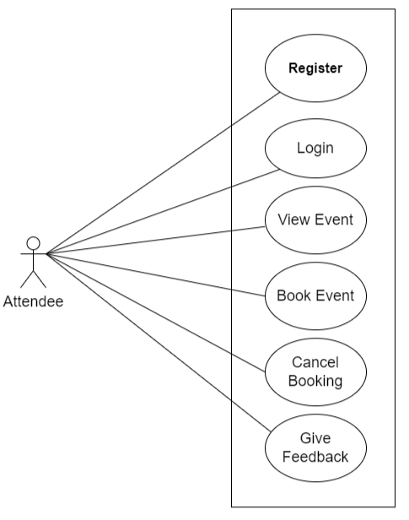
Use Case:
Attendee :

Slide 8
Users and Use Case:
Admin :
Login
Approve/Reject Organizer
View Events
Create category
Create venue
View Transactions
View Feedback

Slide 9
User and Use Case:
Organizer :
Register
Login
Add Event
Update Event details
View Booking
Cancel Events
editInfo
View Feedback

Slide 10
User and Use Case:
Attendee :
Register
Login
View Events
Book Event
Cancel Booking
Give Feedback

Slide 11


Project Architecture:
Front End
Middle tier with Microservices architecture
DB Tier
Web server running on localhost: 3000
.NET Rest API Server
for User Management
APIs on localhost: 8090
Entity Framework ADO .NET
Using HTML, CSS
Bootstrap
React JS components
Springboot Rest API Server for Business
APIs on localhost: 8080
JPA
Hibernate
JDBC
Running on 3306

Slide 12
Project Methodology:
Phase 1:
In phase one we have implemented Registration and Login for all Modules such as registration for Organizer and Attendee whereas Admin has only Login.
Phase 2:
In phase two we have implemented all the CRUD operations such as add event , delete event, update the event, view the event ,delete attendee and organizer , view payments for attendees who booked tickets and organizer who booked for the event, view bookings done, cancel the booking .
Phase 3:
In the third phase of our project, we introduced the implementation of transactions. Transactions are essentially a way to ensure that multiple operations related to the booking process either happen entire or don't happen at all. This is crucial for maintaining the integrity and consistency of data in our system

Slide 13
GitHub Repository:
https://github.com/18prasad/EventHub

Slide 14
Testing approach:
Testing done at different tiers :
.NET Rest API using Swagger
Springboot Rest API using postman.
Manual/Browser testing for react components

Slide 15
Future extensions:
More Ticket Choices: Allow organizers to offer different types of tickets (like VIP or regular) with different prices and perks.
Pick Your Seat: Let attendees choose where they want to sit in the venue from a map.
Get Reminders: Send reminders so people don't forget about their booked events.
Share on Social Media: Make it easy for users to share their booked events on platforms like Facebook or Instagram
Find Similar Events: Recommend other events people might like based on what they've booked before

Slide 16
Experience and Lesson Learnt:
The EventHub project taught us a lot about dealing with a complex system. We had to juggle many different parts, like user sign-ups, managing events, selling tickets, and sending notifications. It was like putting together a big puzzle! We also learned how to use Git and GitHub, which helped us work together smoothly. Sometimes, things didn't go as planed, we ran into unexpected problems and bugs in the code. But each time, we learned something new and figured out how to fix it.
Overall, the project showed us the importance of breaking down things into smaller pieces, listening to user feedback, and working together as a team to solve problems. It was a valuable learning experience that will help us in future projects

Slide 17
THANK YOU

